Slide 1
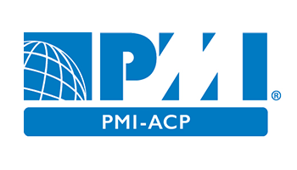
PMI Agile Certified Practitioner Exam Prep
PMI –ACP ®

Slide 2
PMI-Agile Certified Practitioner® Exam Prep
PMI-ACP Course Introduction
Domain – I Agile Framework
Domain – II Value Driven Delivery
Domain – III Stakeholder Engagement
Domain – IV Boosting Team Performance Practices
Domain – V Adaptive Planning
Domain – VI Problem Detection and Resolution
Domain – VII Continuous Improvement

Slide 3
PMI-ACP Certification Process

